Slide 1
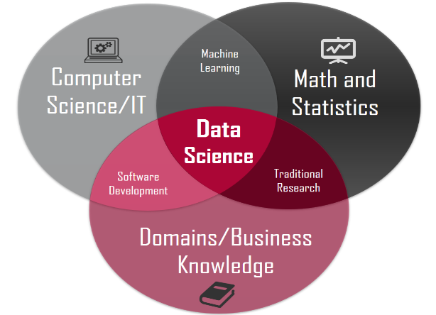

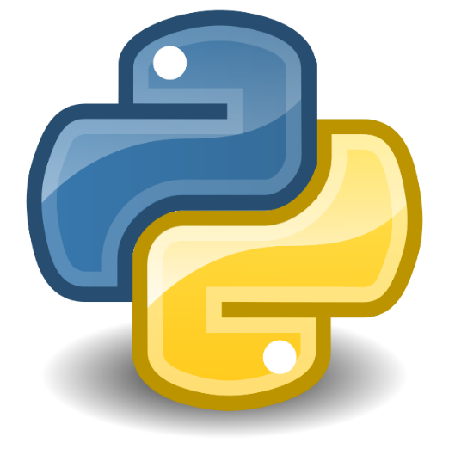
Introduction To R Programming
Prepared By: Dr. Ronak Panchal , Ph.D in Computer Science
IT Project Manager, Cognizant, Pune
Website blog: http://drronakpanchal.wordpress.com

Slide 2
Agenda
Introduction to R and RStudio
Introduction to IDE for R
Features of R
Application & tools of R
Basic Command of R
R Datatypes
Demo

Slide 3

What is R Programming…?

Slide 4

R, an open-source statistical and data mining programming language. I believe R will eventually replace SAS as the language of choice for modeling and analysis for most organizations. The primary reason for this is plainly commercial. Most organizations are questioning the heavy annual cost of SAS on their P&L statement. R is a highly advanced language with over 5000 add-on packages to assist in data management and analysis. Most senior analysts and analytics leaders have already started polishing their skills on R.

Slide 5
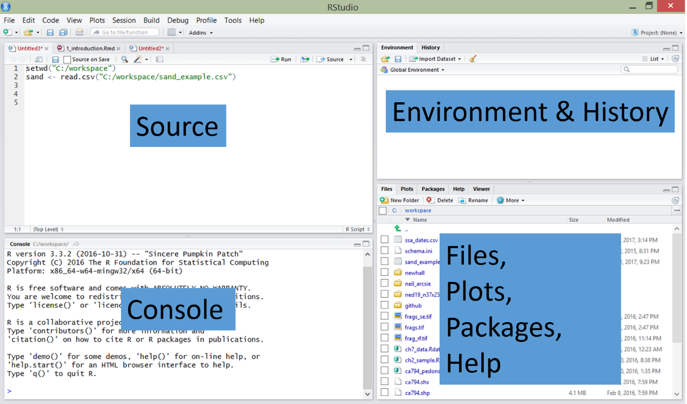
RStudio: An Integrated Development Environment (IDE) for R

Slide 6
RStudio: An Integrated Development Environment (IDE) for R
RStudio is an integrated development environment (IDE) that allows you to interact with R more readily. RStudio is similar to the standard RGui, but is considerably more user friendly.
It has more drop-down menus, windows with multiple tabs, and many customization options. The first time you open RStudio, you will see three windows. A forth window is hidden by default, but can be opened by clicking the File drop-down menu, then New File, and then R Script.. Detailed information on using RStudio can be found at at RStudio’s Website

Slide 7
R Studio is an integrated development environment (IDE) for R. It includes a console, syntax-highlighting editor that supports direct code execution, as well as tools for plotting, history, debugging and workspace management.
When you launch RStudio, you will see the following four windows or panes.
Source
Console
Environment/History
Files/Plots/Packages/Help

Slide 8
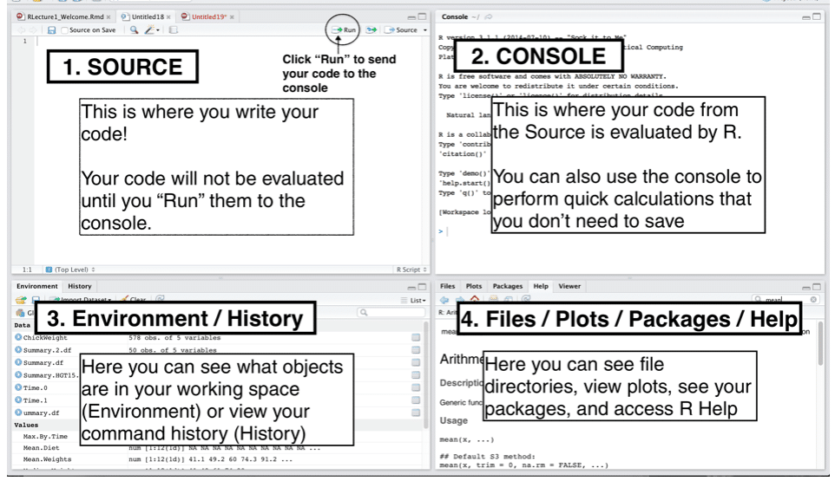

Slide 9
Features of R Programming
Open-source. R is an open-source software environment. ...
Strong Graphical Capabilities. ...
Highly Active Community. ...
A Wide Selection of Packages. ...
Comprehensive Environment. ...
Can Perform Complex Statistical Calculations. ...
Distributed Computing. ...
Running Code Without a Compiler.

Slide 10
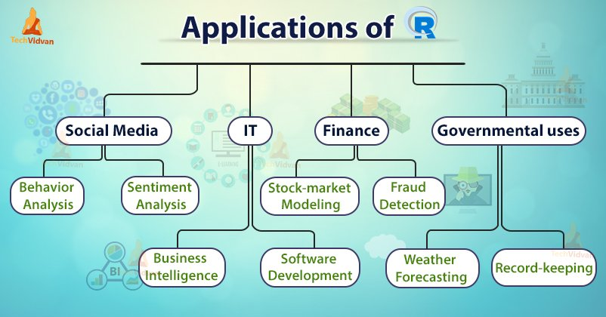
Application of R Programming

Slide 11
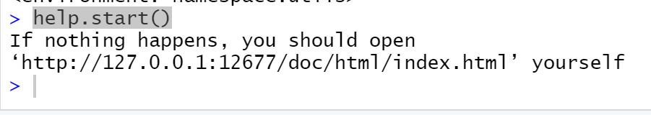
Basic R commands
Help
?help
help.start()
> myString <- "Hello, World!"
> print ( myString)
[1] "Hello, World!"

Slide 12
What is Data Science?
Data science is the domain of study that deals with vast volumes of data using modern tools and techniques to find unseen patterns, derive meaningful information, and make business decisions.
Data science uses complex machine learning algorithms to build predictive models.

Slide 13
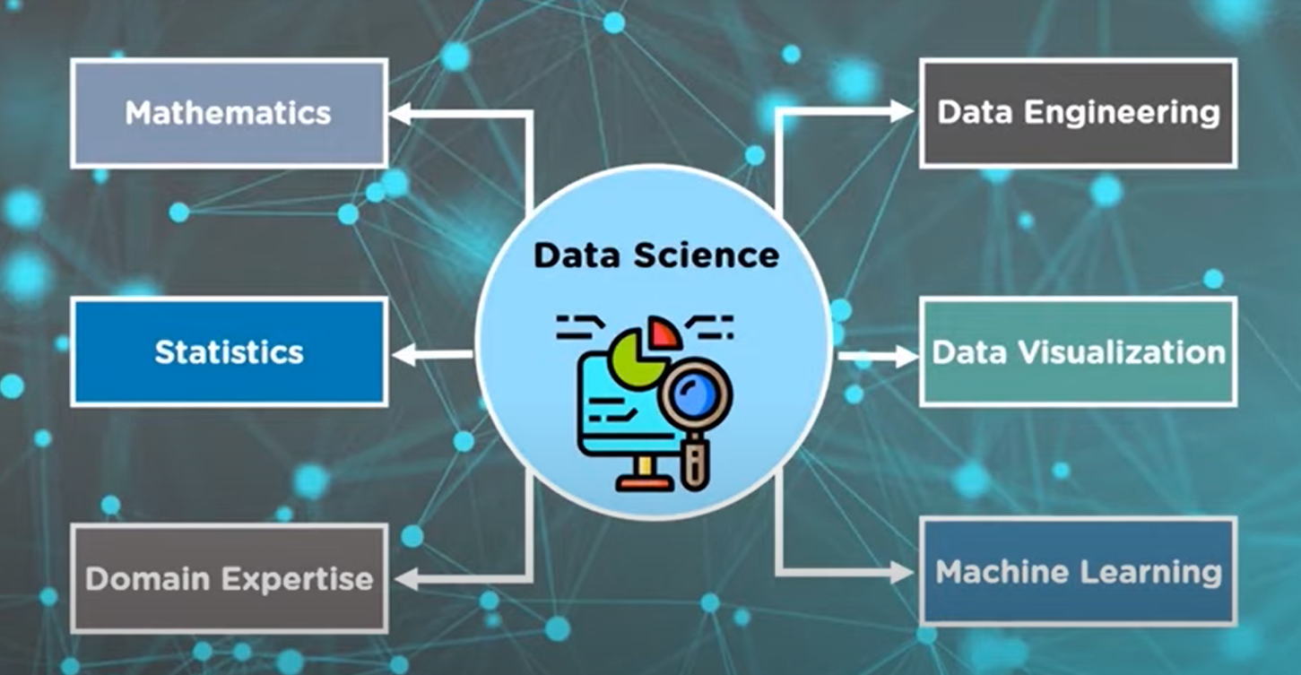
Data Science Components

Slide 14
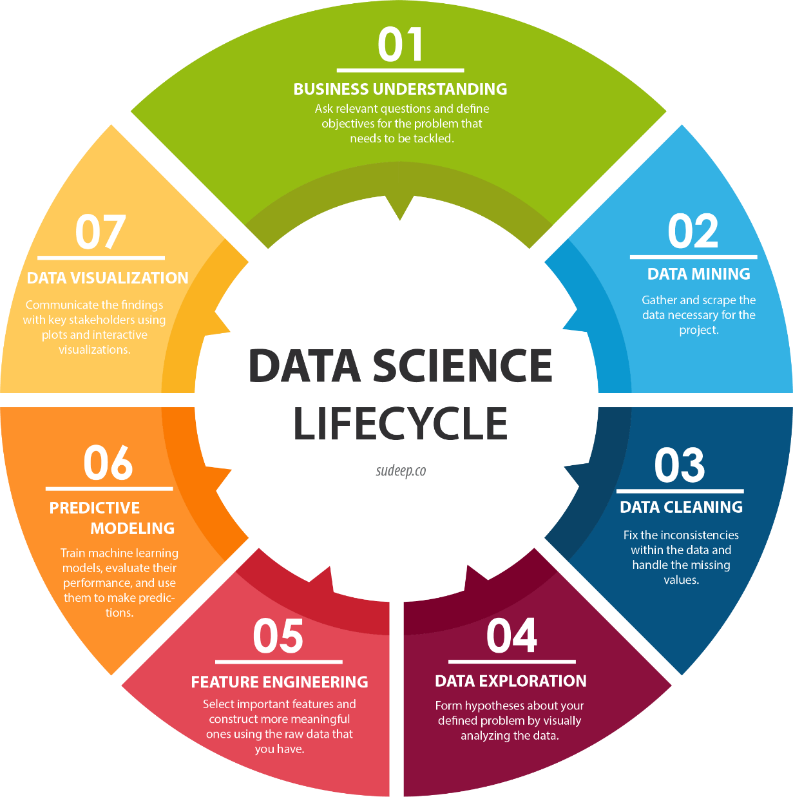

Slide 15

Basic Steps
Business understanding
Data acquisition and understanding
Modeling
Deployment
Customer acceptance

Slide 16
Business Intelligence Vs Data Science
Business Intelligence | Data Science
Uses structured data | Uses both structured and unstructured data
Analytical in nature - provides a historical report of the data | Scientific in nature - perform an in-depth statistical analysis on the data
Use of basic statistics with emphasis on visualization (dashboards, reports) | Leverages more sophisticated statistical and predictive analysis and machine learning (ML)
Compares historical data to current data to identify trends | Combines historical and current data to predict future performance and outcomes

Slide 17
Data Science Tools & Libraries
NumPy
SciPy
BeautifulSoup
Scrappy
Pandas
Matplotlib
Plotly
Seaborn
Scikit Learn
PyCaret
TensorFlow
Keras
PyTorch
The data science profession is challenging, but fortunately, there are plenty of tools available to help the data scientist succeed at their job.
Data Analysis: SAS, Jupyter, R Studio, MATLAB, Excel, RapidMiner, Orange – Data Mining.
Data Warehousing: Informatica/ Talend, AWS Redshift
Data Visualization: Jupyter, Tableau, PowerBI, Qlik, looker, Data Studio
Machine Learning: Spark MLib, Mahout, Azure ML studio - Data Bricks, AWS SageMaker

Slide 18
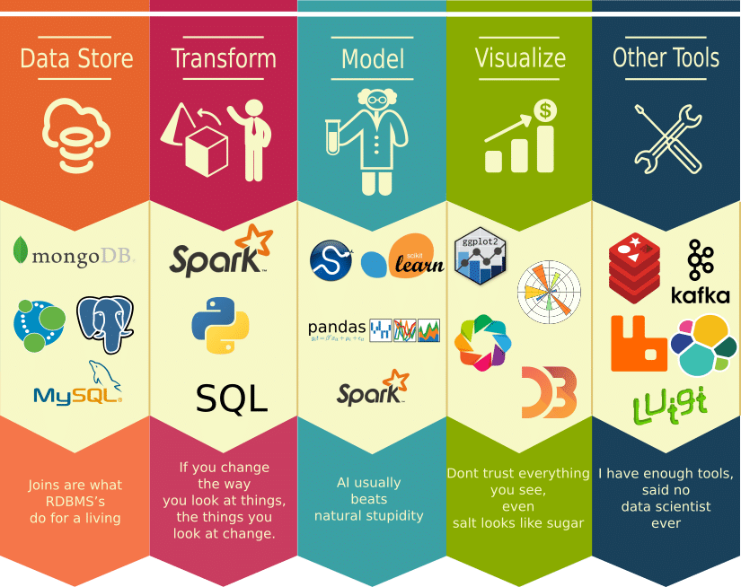
Data Science Tools

Slide 19
Application of Data Science
Data science has found its applications in almost every industry
1. Healthcare
Healthcare companies are using data science to build sophisticated medical instruments to detect and cure diseases.
2. Gaming
Video and computer games are now being created with the help of data science and that has taken the gaming experience to the next level.
3. Image Recognition
Identifying patterns in images and detecting objects in an image is one of the most popular data science applications.
4. Recommendation Systems
Netflix and Amazon give movie and product recommendations based on what you like to watch, purchase, or browse on their platforms.
5. Logistics
Data Science is used by logistics companies to optimize routes to ensure faster delivery of products and increase operational efficiency.
6. Fraud Detection
Banking and financial institutions use data science and related algorithms to detect fraudulent transactions.
- Many more

Slide 20
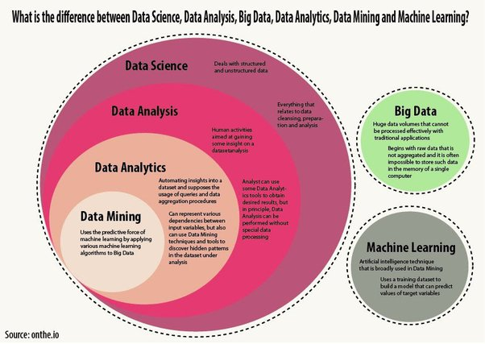

Slide 21
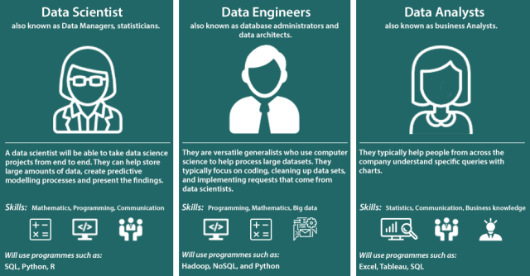

Slide 22
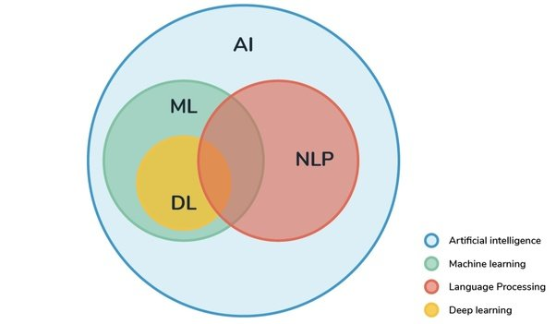
Relationship between AI, ML, DL and NLP

Slide 23
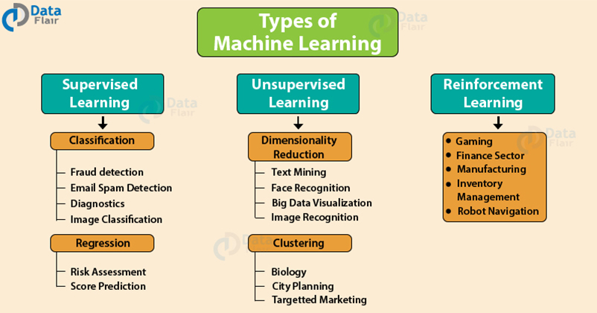

Slide 24
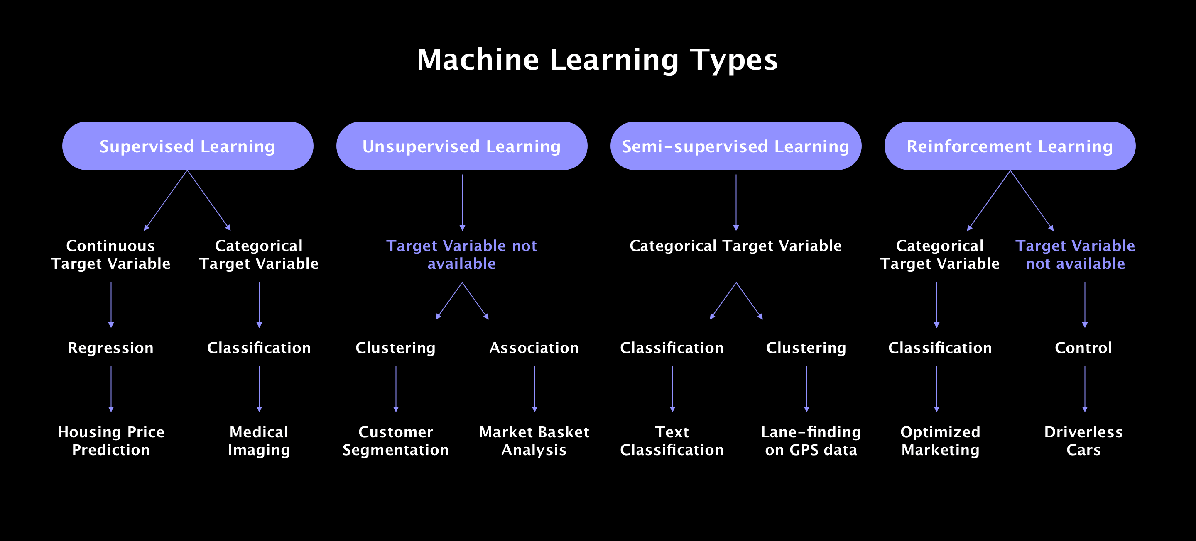

Slide 25
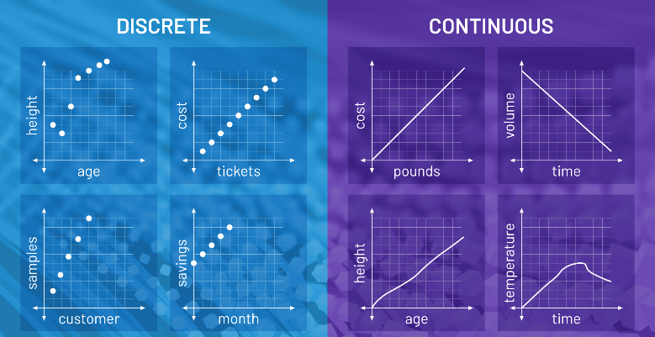
Discrete Vs Continuous Data
Discrete data is information that can only take certain values.
It only contains finite values or Discrete data is countable.
Discrete Data Examples: The number of students in a class, the number of chocolates in a bag, the number of strings on the guitar, the number of fishes in the aquarium, etc.
Continuous data is data that can take any value. Height, weight, temperature and length are all examples of continuous data.
It only contains infinite values or continuous — measurable.
Continuous Data Examples: Measurement of height and weight of a student, Daily temperature measurement of a place, Wind speed measured daily, etc.

Slide 26
Difference between Regression and Classification
Regression Algorithm | Classification Algorithm
In Regression, the output variable must be of continuous nature or real value. | In Classification, the output variable must be a discrete value.
The task of the regression algorithm is to map the input value (x) with the continuous output variable(y). | The task of the classification algorithm is to map the input value(x) with the discrete output variable(y).
Regression Algorithms are used with continuous data. | Classification Algorithms are used with discrete data.
In Regression, we try to find the best fit line, which can predict the output more accurately. | In Classification, we try to find the decision boundary, which can divide the dataset into different classes.
Regression algorithms can be used to solve the regression problems such as Weather Prediction, House price prediction, etc. | Classification Algorithms can be used to solve classification problems such as Identification of spam emails, Speech Recognition, Identification of cancer cells, etc.
The regression Algorithm can be further divided into Linear and Non-linear Regression. | The Classification algorithms can be divided into Binary Classifier and Multi-class Classifier.
Simple Linear Regression Multiple Linear Regression Polynomial Regression Support Vector Regression Decision Tree Regression Random Forest Regression | Logistic Regression K-Nearest Neighbours Support Vector Machines Kernel SVM Naïve Bayes Decision Tree Classification Random Forest Classification

Slide 27
Classification of Data Science
1. ML - Small amout of dataset
2. DL - On Large amout or Big Dataset
3. NLP - Text Analyzing and Text Mining

Slide 28

Now time to understand NLP

Slide 29
NLP (Natural Language Processing)
Natural Language Processing (NLP) is a field of Artificial Intelligence (AI) that makes human language intelligible to machines. NLP combines the power of linguistics and computer science to study the rules and structure of language, and create intelligent systems (run on machine learning and NLP algorithms) capable of understanding, analyzing, and extracting meaning from text and speech.

Slide 30
Natural Language Processing (NLP) allows machines to break down and interpret human language. It’s at the core of tools we use every day – from translation software, chatbots, spam filters, and search engines, to grammar correction software, voice assistants, and social media monitoring tools.

Slide 31
Live famous example of NLP
NLP is used to understand the structure and meaning of human language by analyzing different aspects like syntax, semantics, pragmatics, and morphology. Then, computer science transforms this linguistic knowledge into rule-based, machine learning algorithms that can solve specific problems and perform desired tasks.
Take Gmail example, Emails are automatically categorized as Promotions, Social, Primary, or Spam, thanks to an NLP task called keyword extraction. By “reading” words in subject lines and associating them with predetermined tags, machines automatically learn which category to assign email’s label.

Slide 32
Common Examples of NLP
Email filters
Virtual assistants, voice assistants, or smart speakers
Online search engines
Predictive text and autocorrect
Monitor brand sentiment on social media
Sorting customer feedback
Automating processes in customer support
Chatbots
Automatic summarization
Machine translation
Natural language generation

Slide 33
Library of NLP
MonkeyLearn is a SaaS platform that lets you build customized natural language processing models to perform tasks like sentiment analysis and keyword extraction. Developers can connect NLP models via the API in Python, while those with no programming skills can upload datasets via the smart interface, or connect to everyday apps like Google Sheets, Excel, Zapier, Zendesk, and more.
Natural Language Toolkit (NLTK) is a suite of libraries for building Python programs that can deal with a wide variety of NLP tasks. It is the most popular Python library for NLP, has a very active community behind it, and is often used for educational purposes. There is a handbook and tutorial for using NLTK, but it’s a pretty steep learning curve.
SpaCy is a free open-source library for advanced natural language processing in Python. It has been specifically designed to build NLP applications that can help you understand large volumes of text.
TextBlob is a Python library with a simple interface to perform a variety of NLP tasks. Built on the shoulders of NLTK and another library called Pattern, it is intuitive and user-friendly, which makes it ideal for beginners. Learn more about how to use TextBlob and its features.

Slide 34
NLP (Natural Language Processing): It understands the text's meaning. NLU (Natural Language Understanding): Whole processes such as decisions and actions are taken by NLP. NLG (Natural Language Generation): It generates the human language text from structured data generated by the system to respond.
NLP
Natural Language Processing
NLU
Natural Language Understanding
Siri, Alexa, Hello Google
NLG
Natural Language Generation
Text/Sentence Planning
Speech Recognise
Challenges (Lexical, semantic, syntactic, pragmatic ambiguity)
A combination of NLU and NLG gives an NLP system.

Slide 35
common techniques that you can use to handle your text data using NLP
Tokenization
Stop Words Removal
Lemmatization and stemming
Word Embeddings (word that have same meaning)
Term Frequency-Inverse Document Frequency (TF-IDF)
Topic Modeling
Sentiment Analysis
Summarization
Keywords extraction
Named Entity Recognition (NER)

Slide 36
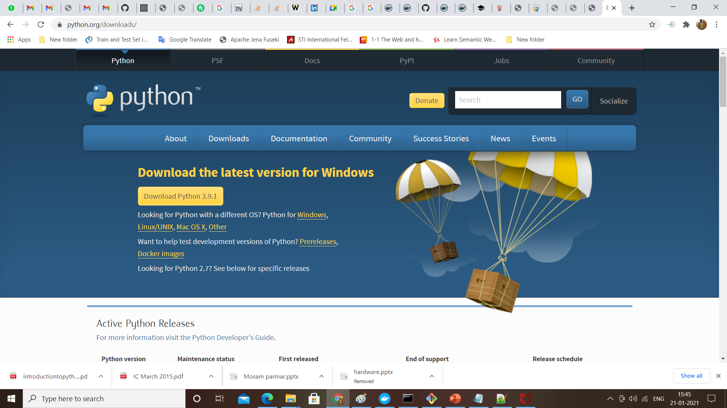
Installing Python
Current Version: 3.9.1
Python is pre-installed on most Unix systems, including Linux and MAC OS X
But for in Windows Operating Systems , user can download from the https://www.python.org/downloads/
from the above link download latest version of python IDE and install, recent version is 3.9.1 but most of them uses version 2.7.7 only

Slide 37
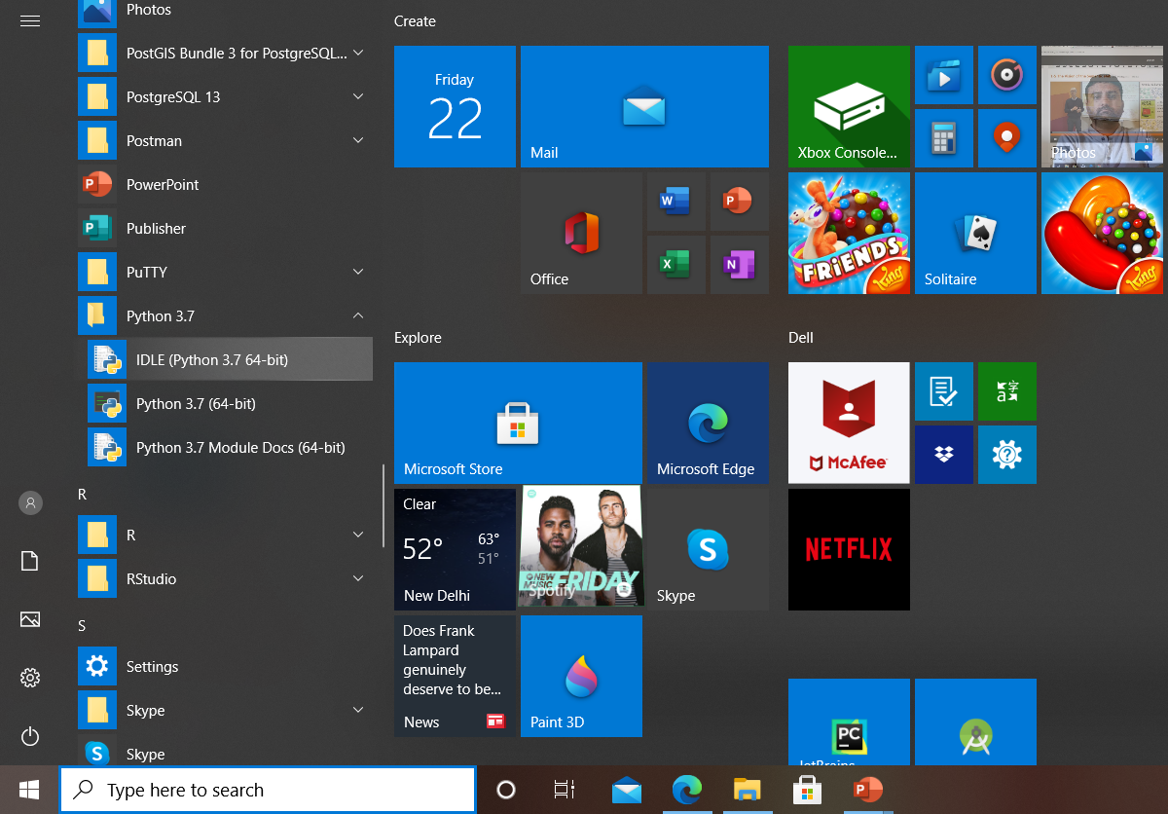
How to find python in windows
Once installation is completed.
Go To All Program
Click on Python IDLE

Slide 38
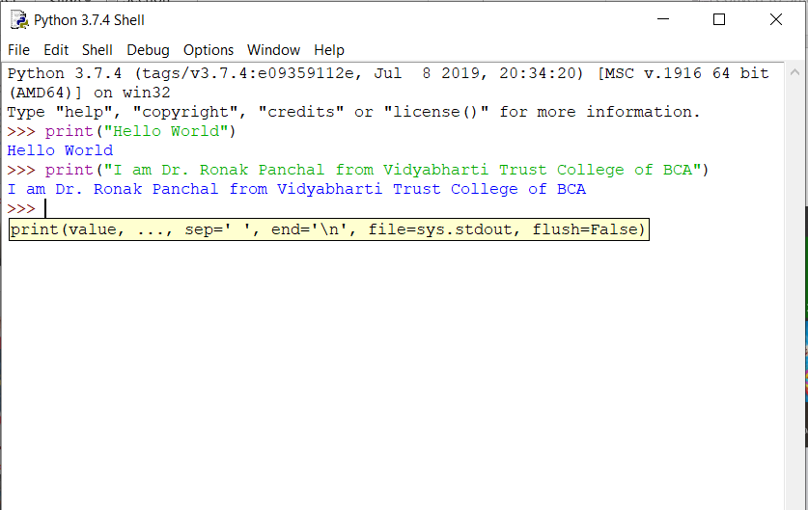
Now see first screen of Python IDLE

Slide 39


Let’s explore the universe

Slide 40
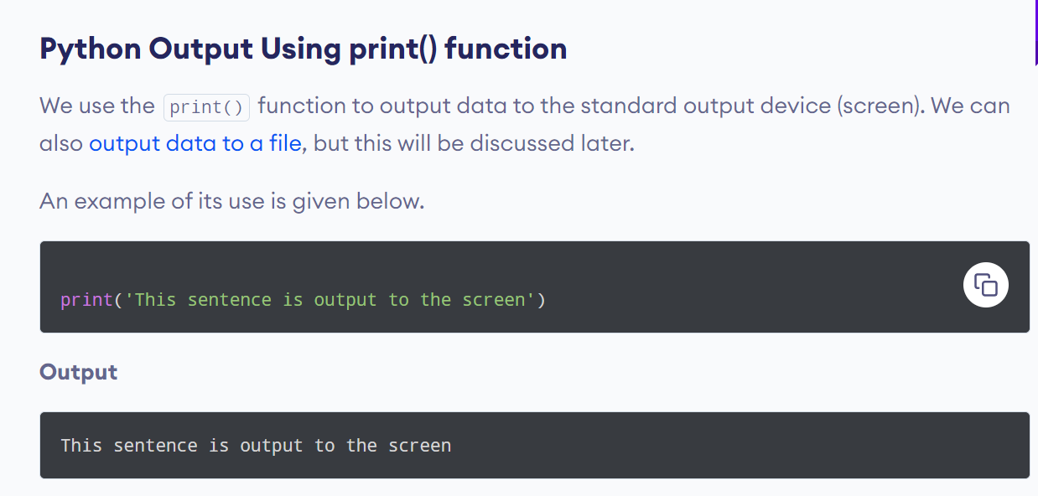

Slide 41
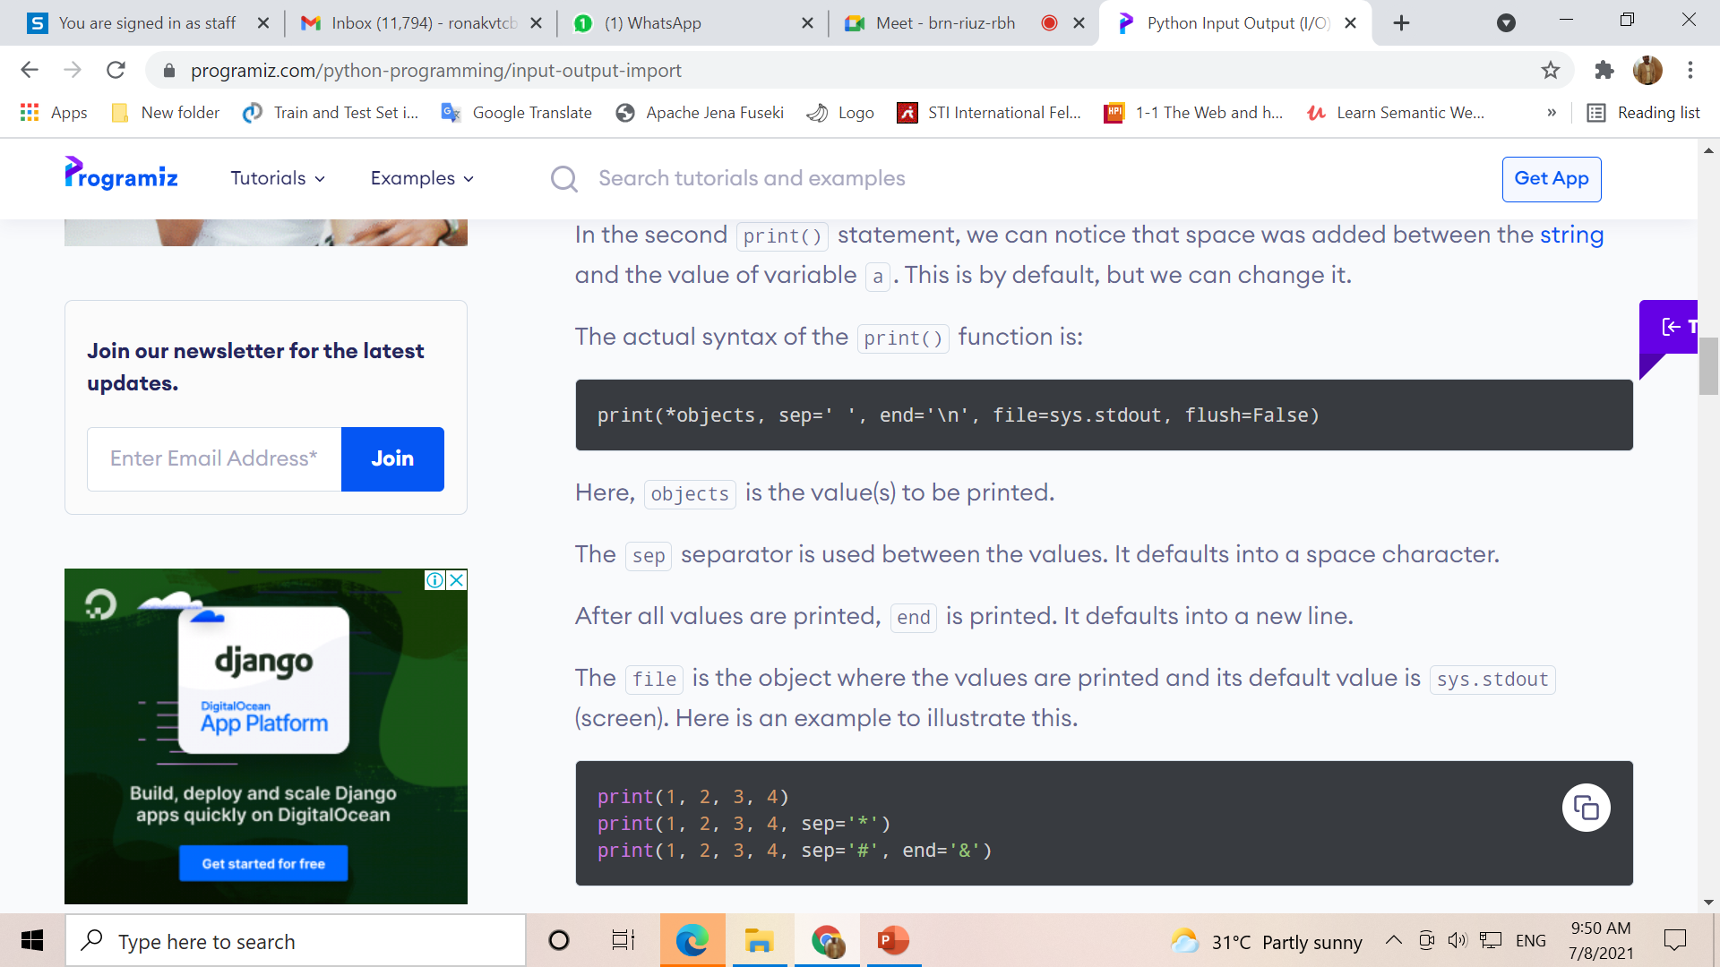

Slide 42
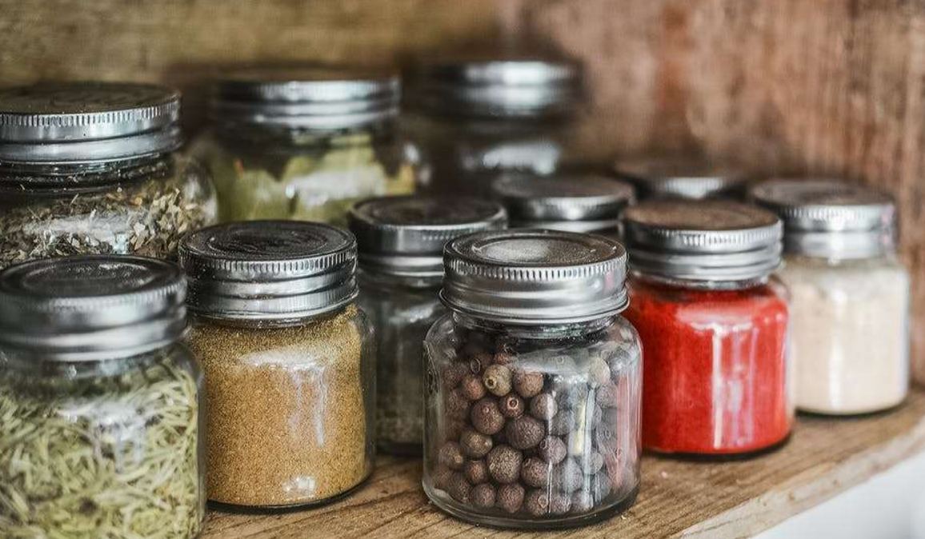
Variables and Data Types in Real Life

Slide 43
Variable
No need to declare
Need to assign (initialize)
use of uninitialized variable raises exception
Not typed
if friendly:
greeting = "hello world"
else:
greeting = 12**2
print greeting
Everything is a "variable":
Even functions, classes, modules
Type statements or expressions at prompt:
>>> print "Hello, world"
Hello, world
>>> x = 12**2
>>> x/2
72
>>> # this is a comment

Slide 44
Data Types
Variables store and give names to data values
Data values can be of various types:
int : -5, 0, 1000000
float : -2.0, 3.14159
bool : True, False
str : "Hello world!", "K3WL"
list : [1, 2, 3, 4], ["Hello", "world!"], [1, 2, "Hello"], [ ]
And many more!
In Python, variables do not have types!
Data values are assigned to variables using "="
x = 1 # this is a Python comment
x = x + 5
y = "Python" + " is " + "cool!"

Slide 45
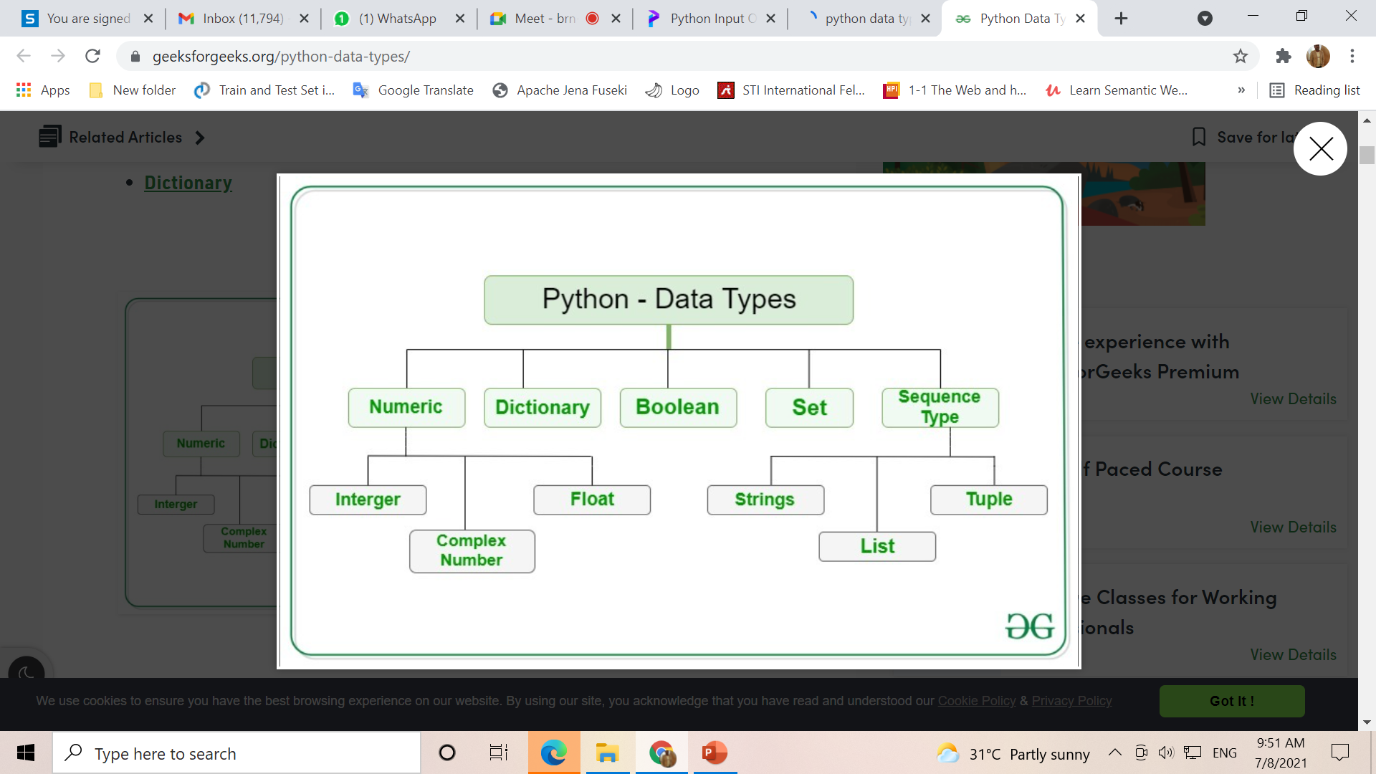

Slide 46
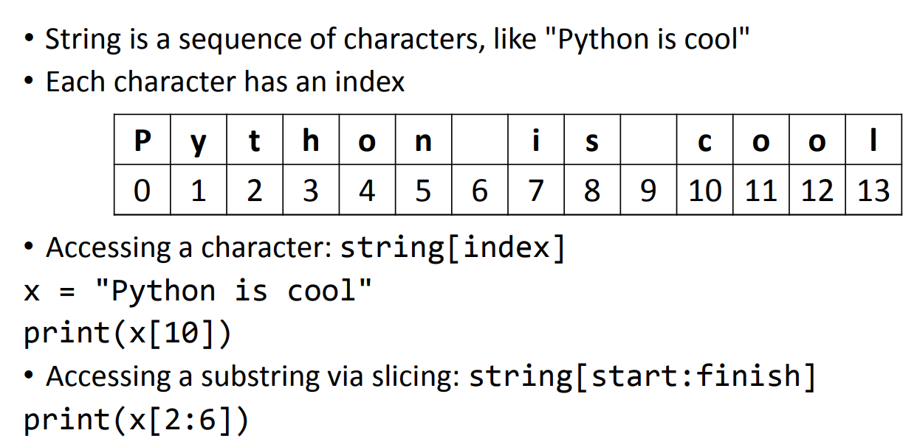
Basic string

Slide 47
Basic string operation
“hello”+”world” “helloworld” # concatenation
"hello"*3 "hellohellohello" # repetition
"hello"[0] "h" # indexing
"hello"[-1] "o" # (from end)
"hello"[1:4] "ell" # slicing
len("hello") 5 # size
"hello" < "jello" 1 # comparison
"e" in "hello" 1 # search
"escapes: \n etc, \033 etc, \if etc"
'single quotes' """triple quotes""" r"raw strings"

Slide 48
Conditional Statements
The if statement
The if else statement
Chained conditionals
Nested if

Slide 49
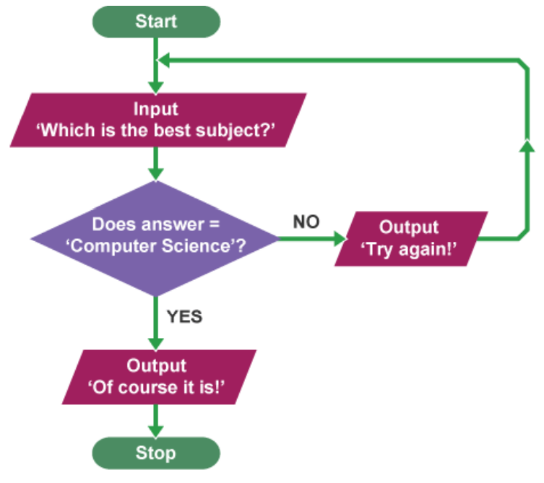
Conditionals and Loops
if condition:
statements
[elif condition:
statements] ...
else:
statements
while condition:
statements
for var in sequence:
statements
break
continue

Slide 50
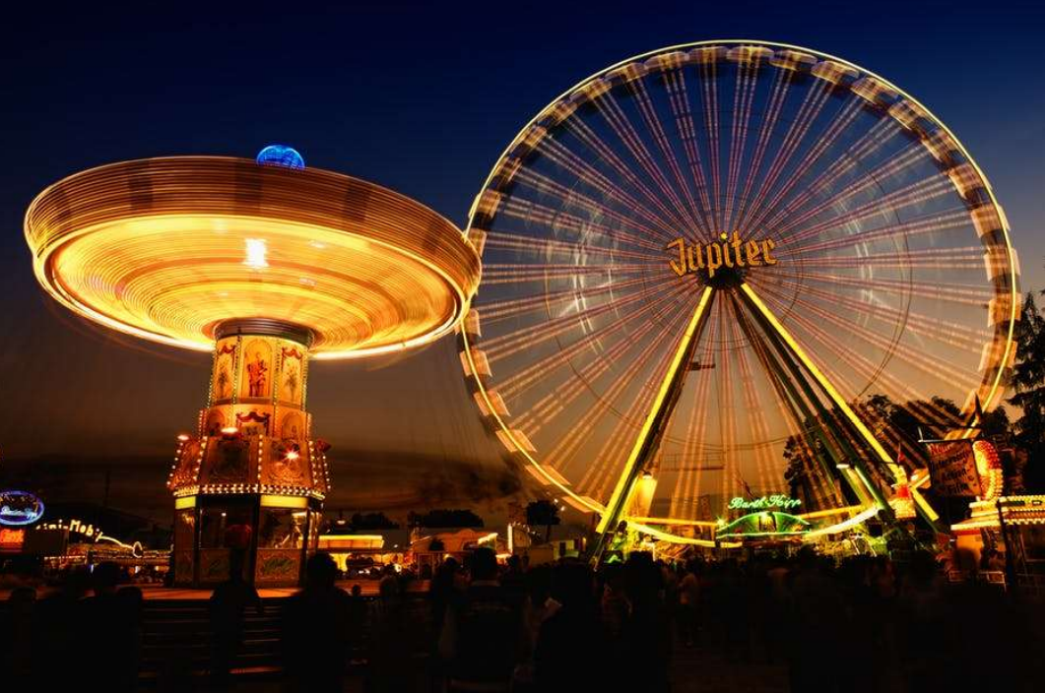
Conditionals and Loops in Real Life

Slide 51
Loop / Iteration
A loop is syntax structure that repeats all the statements within the loop until the exit condition is met.
While..
For loop

Slide 52
Conditionals: Generic Form
if boolean-expression-1:
code-block-1
elif boolean-expression-2:
code-block-2
(as many elif's as you want)
else:
code-block-last

Slide 53
Conditionals: Driving license age
age = 20
if age < 18:
print(“Not Eligible!")
else:
print("OK, Eligible.")

Slide 54
Conditionals: using Input
age = int(raw_input(“Enter Age: "))
# use input() for Python 3
if age < 18:
print(“Not Eligible!")
else:
print("OK, Eligible.")

Slide 55
Conditionals: Grading
grade = int(raw_input("Numeric grade: "))
# use input() for Python 3
if grade >= 80:
print("A")
elif grade >= 65:
print("B")
elif grade >= 55:
print("C")
else:
print("E")

Slide 56
Loops
Useful for repeating code!
Two variants:
while boolean-expression:
code-block
for element in collection:
code-block

Slide 57
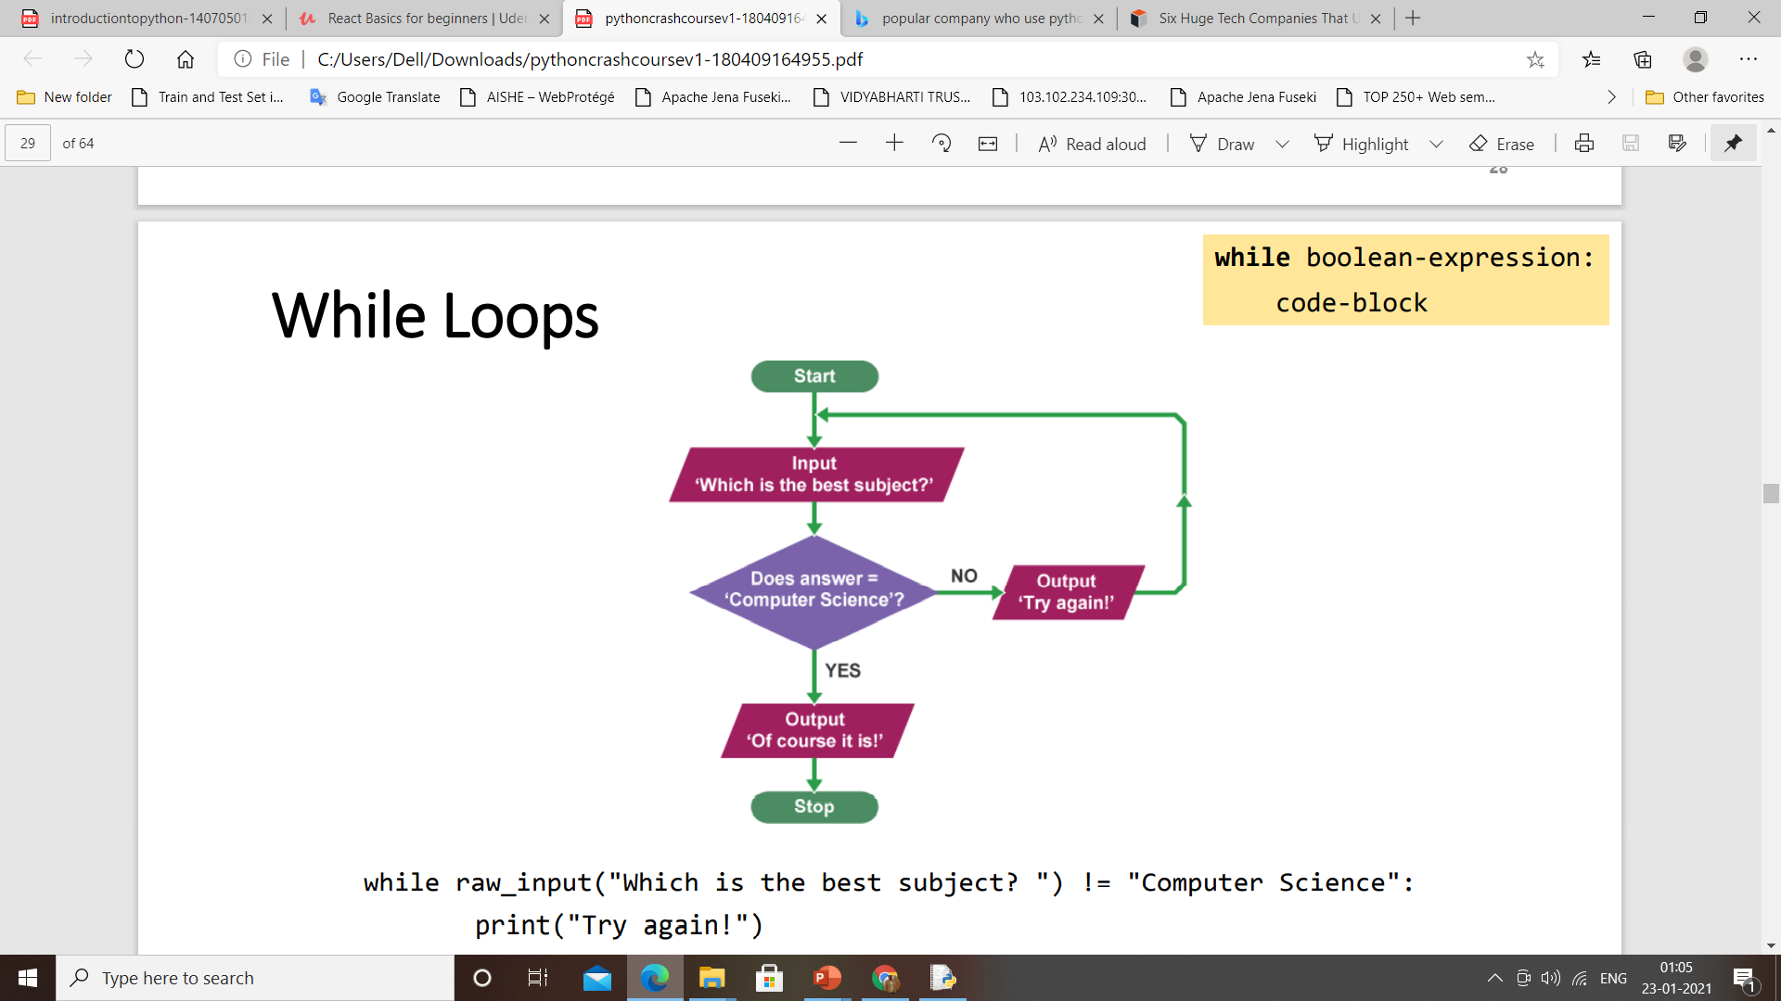
While Loop
while raw_input("Which is the best subject? ") != "Computer Science": print("Try again!")
print("Of course it is!")

Slide 58
For Loops
So far, we have seen (briefly) two kinds of collections: string and list
For loops can be used to visit each collection's element:
for chr in "string":
print(chr)
for elem in [1,3,5]:
print(elem)

Slide 59
Functions
Functions encapsulate (= membungkus) code blocks
Why functions? Modularization and reuse!
You actually have seen examples of functions:
print()
raw_input() or input() [up to version 3]
Generic form:
def function-name(parameters):
code-block
return value

Slide 60
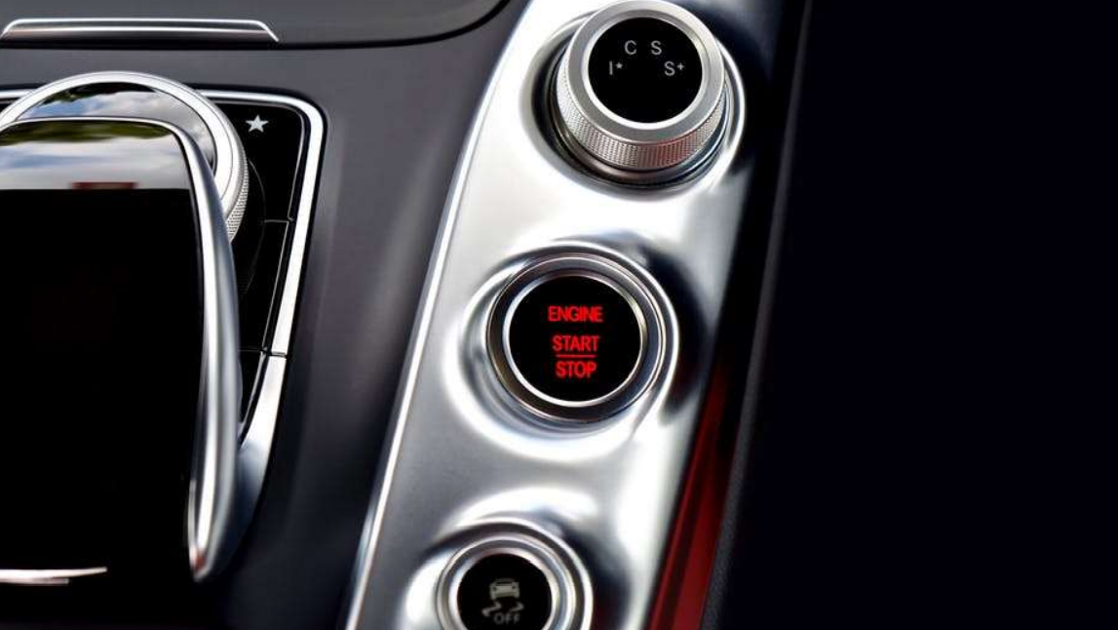
Functions in Real Life

Slide 61
def hello(name_man="Bro", name_woman="Sis"):
print("Hello, " + name_man + " & " + name_woman + "!")
>>> hello()
Hello, Bro & Sis!
>>> hello(name_woman="Lady")
Hello, Bro & Lady!
>>> hello(name_woman=“Maria",name_man=“John")
Hello, John & Maria!

Slide 62
Functions: Celcius to Fahrenheit
def function-name(parameters):
code-block
return value
def celsius_to_fahrenheit(celsius):
fahrenheit = celsius * 1.8 + 32.0 return fahrenheit

Slide 63
Imports statement
Code made by other people shall be reused!
Two ways of importing modules (= Python files):
Generic form: import module_name
import math
print(math.sqrt(4))
Generic form: from module_name
import function_name from math
import sqrt
print(sqrt(4))

Slide 65
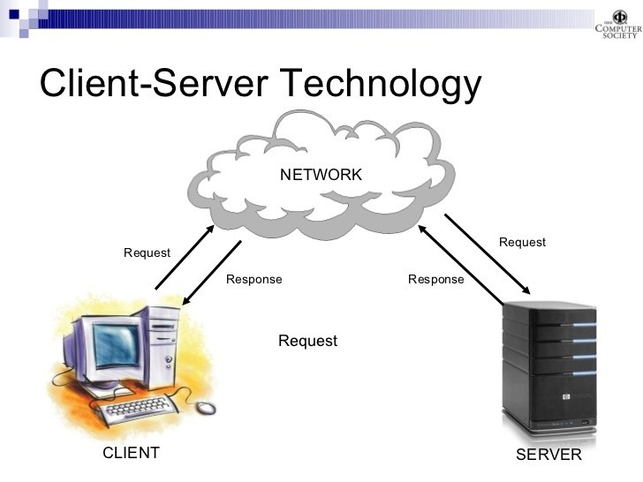
Python Web Technology
What is web technology?

Slide 66
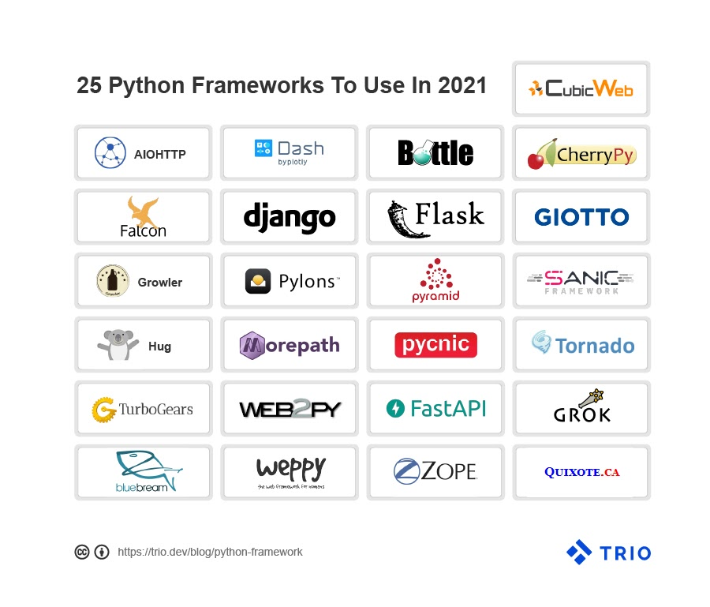

Slide 68
Flask Web Framework
Flask is the Python Based Web development framework classified as the Micro Framework because it does not require any particular library or tool.
Along with that, it does not include form validation, neither hold database abstraction layers nor demand any specific third party libraries. But, it gives you complete flexibility to plug in any extension and also build your own modules. So, if you are really looking for prototyping, Python Flask is the most desirable choice.
It contributes significantly in providing strong support as a fast debugger and built-in developer server that together delivers a seamless performance.

Slide 69
What is Python Flask good for?
It offers an integrated support for unit testing
WSGI 1.0 compliant that forward requests from a web server to a backend
It supports in implementing the RESTful request dispatching
Python Flask is Unicode based that assign code to every language and symbol

Slide 70
Django
Django is a Python Based Model-View-Template Framework for web development. This platform is developer-friendly and ensures convenience in case of data driven or complex web development projects. Here, programmers can write clean, readable and maintainable code during a web app development.
Who uses Django?
Instagram, Google, Quora and YouTube are using Django since it offers advanced features rich with authentication, security and messaging.
Is Django Frontend or backend?
Django is suitable for both frontend and backend development services

Slide 71
Django Framework
Is Django Fast? Is Django worth learning in 2020?
It is designed mainly to create scalable websites and manage the heaviest traffic demands that make Django so impressive. Moreover, it is quite easy to learn and understand so this is beginner’s friendly.
What is Django good for?
It is SEO Optimize and holds an edge over other frameworks
Logical project structure and MVT architecture make it versatile
It provides a rapid development process
Offers excellent documentation in the market

Slide 72

This Is My WordPress Blog
https://drronakpanchal.wordpress.com/

Slide 73
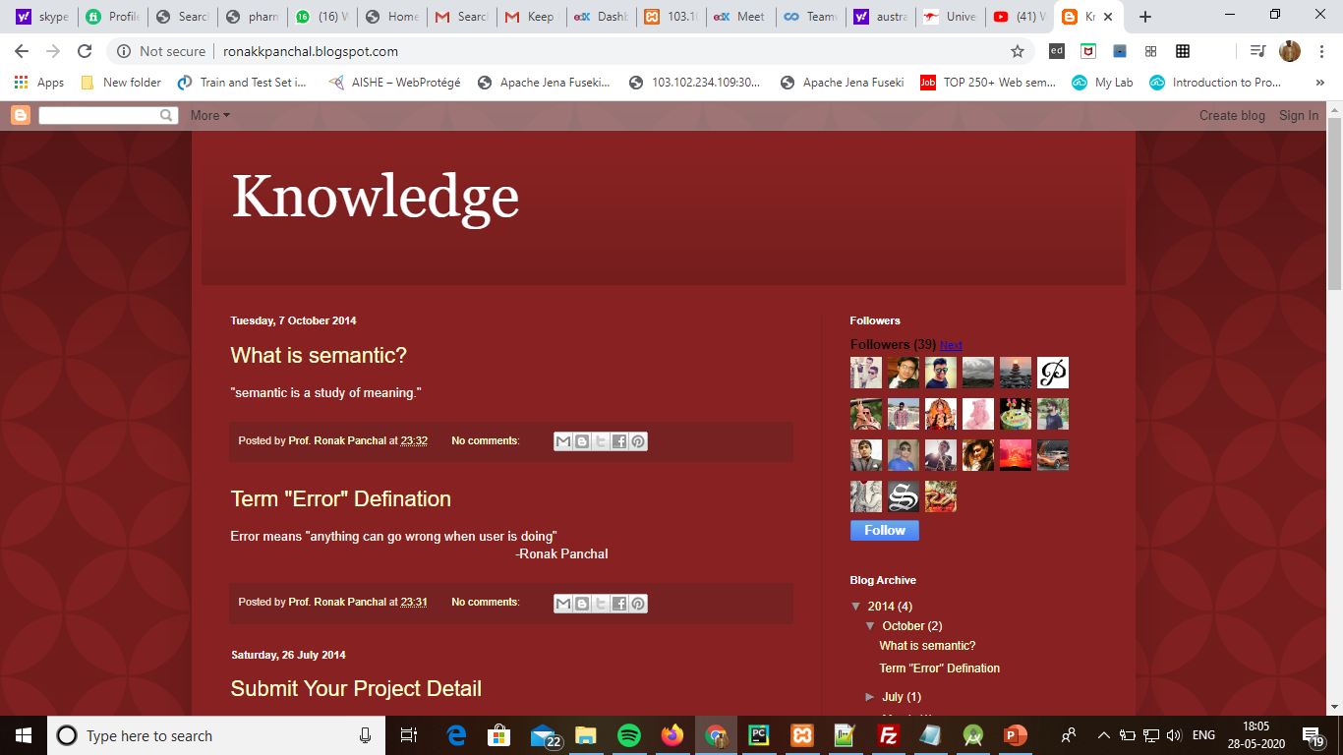
my first blog

Slide 74
Thank You Question & Answer https://drronakpanchal.wordpress.com/ +919898257016 dr.ronak.k.Panchal@gmail.com

